Slide 1


FYP
SpinMaster
Presented by:
Syed Abraash ul Haq (2269-2021)
Mubashir Naveed (2433-2021)
Supervisor : Mr. Aamir Hussain
Co-Supervisor: Mr.Waqas Pasha
Department of Computing, FEST
Hamdard University

Slide 2
Summary
Problem Statement
Objective
FYP Scope
Our methodology
Our Project Plan (Time lines)
Budget / Costing (if any)
FYP Deliverables
Literature Review
Demo of 100% of Work
Experimental Evaluations & Results
Test Plan & Test Cases
References

Slide 3
Problem Statement
Many table tennis players, especially those just starting out or working to improve, find it difficult to understand the different types of spin used during a match.
This makes it harder for them to react properly, improve their skills, or correct their technique.
Traditional coaching often lacks the tools to break down these details in a clear, visual way.
As a result, players miss out on valuable insights that could help them grow.
There’s a real need for a smart, easy-to-use system that can analyze gameplay videos, and give helpful feedback to support better training and performance.

Slide 4
Objective
The main goal of this project is to create a smart and user friendly system that helps table tennis players improve their game by understanding their weakness.
Using computer vision and machine learning, the system will analyze gameplay videos to detect different types of shots, track ball movement, and observe player responses.
The objective is to provide clear feedback that can support better practice, smarter strategy, and overall skill development especially for those who don’t have access to advanced coaching.

Slide 5
FYP Scope
Spin Master helps beginner and intermediate table tennis players improve their game. It analyzes pre-recorded videos to detect shot types, track ball movement, and study player strokes.
The system gives clear feedback to support better training and skill development.
The system does not provide real-time analysis or live match support. It’s not built for professional-level coaching and does not include advanced strategy or biomechanics.

Slide 6
Our Methodology
Spin Master was developed by first identifying the key problems faced by table tennis players in understanding weak shots.
Pre-recorded gameplay videos were used to detect the ball, track its movement, and recognize shot types using computer vision.
Machine learning models were trained to analyze patterns and give feedback on player performance.
The system was tested and improved in phases, and a simple interface was created to present the results clearly.

Slide 7
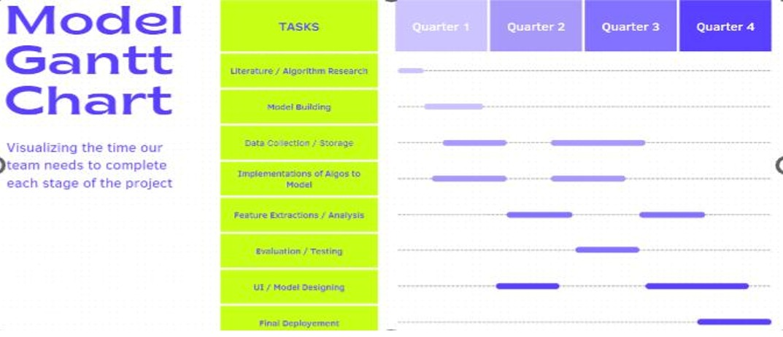
Our Project Plan

Slide 8
Budget / Costing
Hardware Expenses: High-performance computer or workstation: PKR 150,000 External hard drives or NAS: PKR 10,000 Monitors: PKR 30,000 Keyboard and mouse: PKR 5,000 Networking equipment (router, switches): PKR 15,000 Uninterruptible Power Supply (UPS): PKR 15,000 Cooling equipment: PKR 10,000 Total Hardware Expenses: PKR 236,000
Software Expenses:
Software licenses (e.g., PyCharm, Windows OS): PKR 20,000
Database management software: PKR 20,000
Video editing software: PKR 75,000
Total Software Expenses: PKR 115,000
(when commercializing the project)
Cloud Services:
Cloud storage services (e.g., AWS S3, Google Cloud Storage): PKR 64,783 (estimated annual cost)
Total Cloud Services Expenses: PKR 64,783
Other Expenses:
Internet connection (annual subscription): PKR 33,600
Miscellaneous (office supplies, maintenance): PKR 20,000
Total Other Expenses: PKR 53,600
Grand Total Budget: PKR 469,383

Slide 9
FYP Deliverables
FYP-I Evaluation
FYP-II Evaluation
SRS Document
Budget Document
Project Plan
Design Mockup
Data Collection Interface
Project Report - I
Funding Proposal
Survey Paper (First Draft)
UI Design
Proposed System
User Manual
Source Code CD
Project Report - II
Research Paper - (First_Draft)

Slide 10
Literature Review
Recent advancements in computer vision and machine learning have made it possible to analyze sports performance more accurately.
In table tennis, some systems use high-speed cameras and complex setups to detect ball and movement, but these are often expensive and not easily accessible for regular players. Spin Master builds on simpler, cost-effective technologies like OpenCV and CNNs to analyze game using normal gameplay videos.
It provides useful insights without needing advanced equipment, making shot analysis easier and more affordable for beginners and intermediate players.

Slide 11
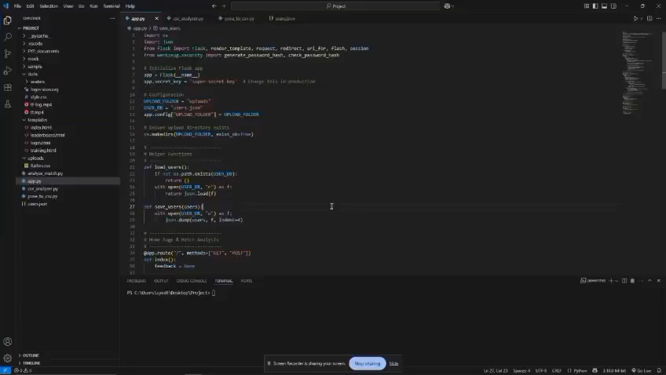
Demo Work

Slide 12
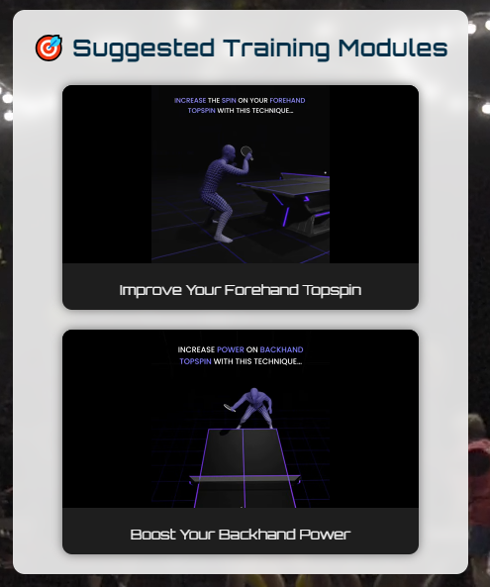
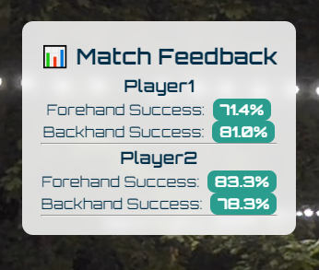
Experimental Evaluations & Results

Slide 13
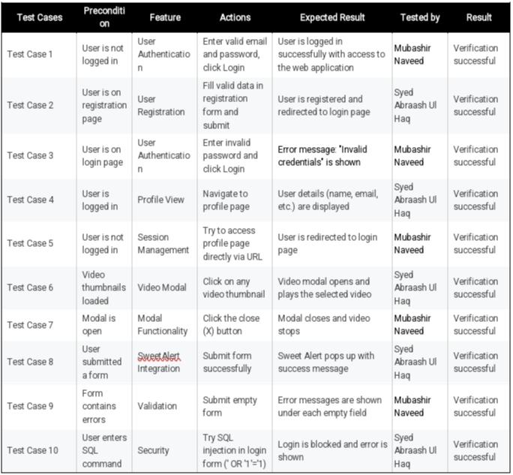
Test Plan & Test Cases

Slide 14
Reference
OSAI.ai. (2022). Table Tennis Stroke Dataset [Dataset]. https://github.com/OSAI-ai/TTNet
Google Research. (2023). MediaPipe: Cross-platform, customizable ML solutions for live and streaming media. https://developers.google.com/mediapipe
Renotte, N. (2021). Deep Learning and Object Detection with YOLO and Roboflow [Linkedin Profile]. https://www.linkedin.com/in/nicholasrenotte/
Roboflow. (2023). Build, Train, and Deploy Computer Vision Models. https://roboflow.com
World Table Tennis (WTT). (2023). Official Player Rankings and Match Statistics. https://worldtabletennis.com
Ultralytics. (2024). YOLOv8 - Real-Time Object Detection Framework [Computer software]. GitHub. https://github.com/ultralytics/ultralytics
Bradski, G. (2000). The OpenCV Library. Dr. Dobb’s Journal of Software Tools. https://opencv.org
Grinberg, M. (2018). Flask Web Development: Developing Web Applications with Python. O'Reilly Media.
Hunter, J. D. (2007). Matplotlib: A 2D Graphics Environment. Computing in Science & Engineering, 9(3), 90–95. https://doi.org/10.1109/MCSE.2007.55
McKinney, W. (2012). Python for Data Analysis: Data Wrangling with Pandas, NumPy, and IPython. O'Reilly Media.
Van Rossum, G., & Drake, F. L. (2009). The Python Language Reference Manual. Network Theory Ltd.
Pedregosa, F., Varoquaux, G., Gramfort, A., Michel, V., Thirion, B., Grisel, O., ... & Duchesnay, É. (2011). Scikit-learn: Machine Learning in Python. Journal of Machine Learning Research, 12, 2825–2830.
Harris, C. R., Millman, K. J., van der Walt, S. J., Gommers, R., Virtanen, P., Cournapeau, D., ... & Oliphant, T. E. (2020). Array Programming with NumPy. Nature, 585(7825), 357–362. https://doi.org/10.1038/s41586-020-2649-2
Reback, J., McKinney, W., jbrockmendel, Van den Bossche, J., Augspurger, T., Cloud, P., ... & Hawkins, S. (2020). Pandas: Powerful Python data analysis toolkit [Computer software]. https://pandas.pydata.org

